Slide 1



Sentiment Analysis
Vijaykumar Mehtre
DSC 680

Slide 2

Introduction
Sentiment analysis can be defined as a process that automates mining of attitudes, opinions, views and emotions from text, speech, tweets and database sources through Natural Language Processing (NLP).
Sentiment analysis involves classifying opinions in text into categories like "positive" or "negative”. It's also referred as subjectivity analysis, opinion mining, and appraisal extraction.
The main goal of this analysis is to discover the underlying sentiment from a user’s tweet.
The opinions that are mined will be classified into two categories positive and negative.
An analysis will then be performed on the classified data to see what percentage of the population sample fall into each category.

Slide 3

Business Problem
A good use case is to identify a customer’s perception for a product, this is an extremely valuable data to some companies.
A company can identify issues with their products, spot trends before their competitors and create improved communications with their target audience.
Gain valuable insight into how effective their marketing campaigns were.
Through this knowledge companies gain valuable feedback which allows them to further develop the next generation of their product.

Slide 4

Approach
1
2
3
4
Data Collection
Data Cleansing
Data Classification
Data Analysis

Slide 5

Data Collection
The dataset provided is the Sentiment140 Dataset which consists of 1,600,000 tweets that have been extracted using the Twitter API. The various columns present in the dataset are:
target: the polarity of the tweet (positive or negative)
ids: Unique id of the tweet
date: the date of the tweet
flag: It refers to the query. If no such query exist’s then it is NO QUERY.
user: It refers to the name of the user that tweeted
text: It refers to the text of the tweet

Slide 6

Data Cleansing
Remove all URLs, hash tags ( #topic), targets (@username)
Remove Stop words.
Replace Repeated Characters.
Remove all punctuations, symbols, numbers.

Slide 7
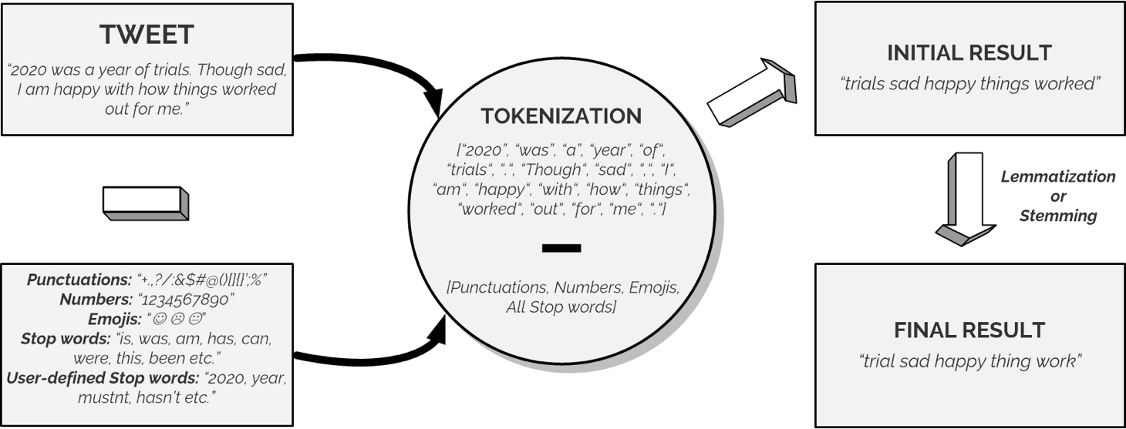
Data Classification
"Tokenization" : A method of splitting a sentence into smaller units called "tokens" to remove unnecessary elements.
"Lemmatization". This is a process of returning words to their "base" form.

Slide 8
Data Classification
“Bag of Words” Model The bag of words approach will involve building databases of positive, negative, and neutral words.
Each tweet will be broken up into individual words and then compared to the words in the databases.
When there is a match, a counter will be incremented or decremented by a fixed amount depending on a weighting assigned.
When this process is complete the counter will be used to classify the sentiment, for example if the words in the tweet are largely positive the counter should be high.
To get the most common words used, we are using the POS-tag (Parts of Speech tagging) module in the NLTK library.
The WordCloud library is used to generate a Word Cloud based on word frequency and superimpose these words on any image.
The Word Cloud shows the words with higher frequency in bigger text size while the "not-so" common words are in smaller text sizes.

Slide 9

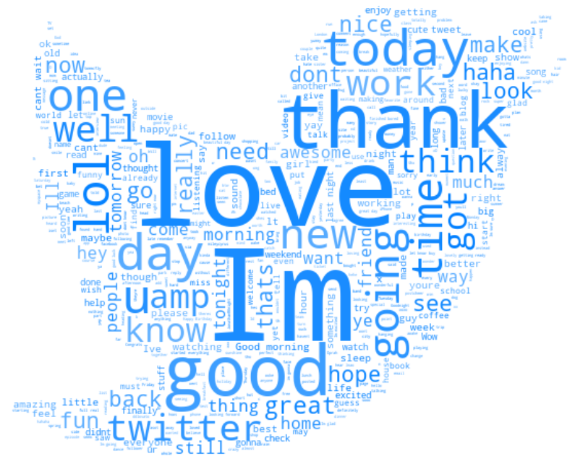
Data Classification
Negative Sentiment Word Cloud
Positive Sentiment Word Cloud

Slide 10
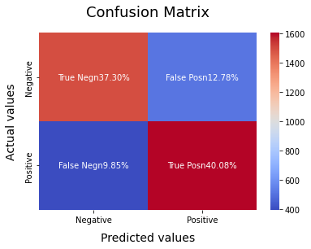
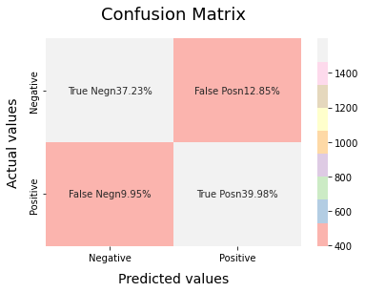
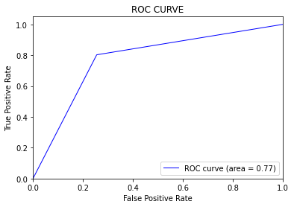
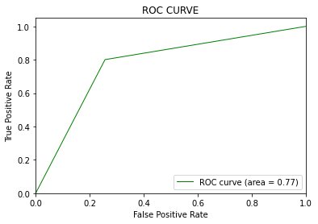
Data Analysis
Logistic Regression
SVM

Slide 11

Conclusion
Overall, we found that Logistic Regression is the best model for analyzing Sentiments on the dataset.
For a particular problem statement if the data has no assumption, then the simplest model works the best.
Notes:
Overall, we found that Logistic Regression is the most effective model for analyzing sentiments in our dataset.
Logistic Regression adheres to the principle of Occam's Razor, which states that the simplest model is often the best choice when there are no assumptions about the data. Given that our dataset lacks specific assumptions and Logistic Regression is inherently simple, this principle holds true for our analysis.

Slide 12

Thank You

